Slide 1
Group 7: Robotic Blackjack Dealer
Kyle Cullen, Nicholas Lowe, Curtis Maher, Luca Mahoney

Slide 2
The Problem and Our Solution
The Business Problem: Reliable, human dealers are costly for casinos, particularly smaller establishments. It can become even more costly to fill all the tables a casino might want to run.
The Customer Problem: Players can also feel uncomfortable with an experienced dealer, or think that they are manipulating cards for a house advantage.
Our Solution: This Robotic Blackjack Dealer is being designed to provide users with an interactive experience of playing Blackjack. It combines the tangibility of playing in real life with the ease of automation found in online games.
Replacing some live dealers with robotic dealers will cut on casino expenses, allow for more players to be hosted, and will allow for a better established trust that there is no cheating or manipulation

Slide 3
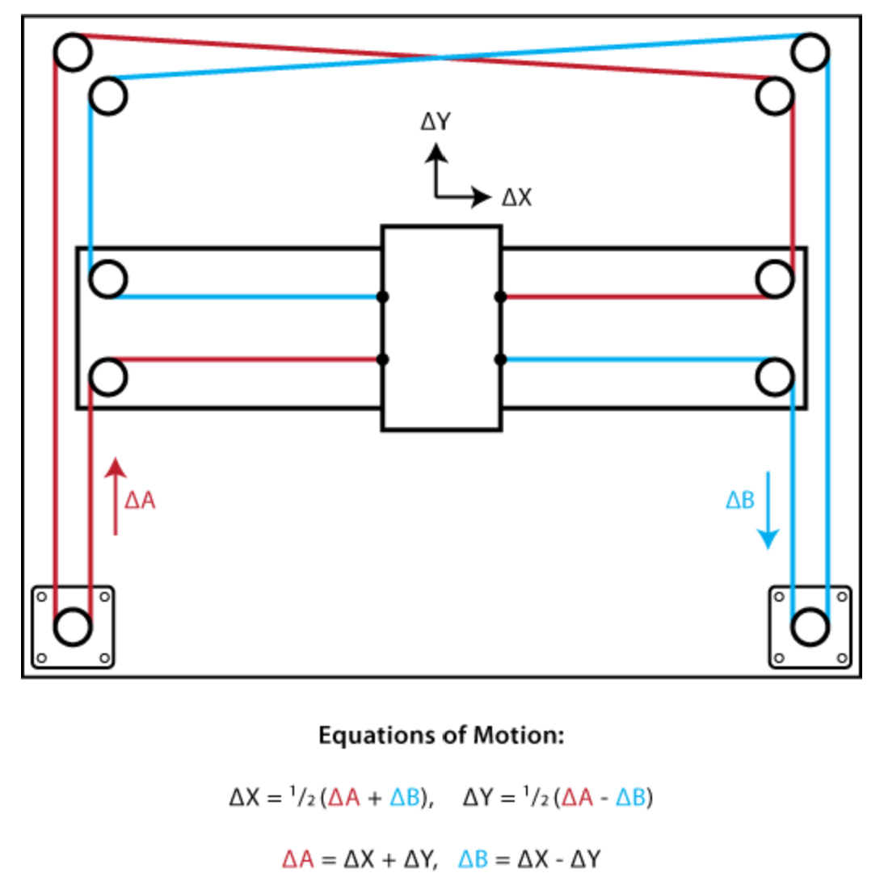
Structure and Gantry Design
Designed an extruded aluminum t-slot structure for component mounting and stability.
Utilizes a “CoreXY” belt and pulley system for controlling gantry motion.
Allows for reduced structural tolerances compared to other methods. Rigidity in particular.
Only requires two motors for full movement on the XY-plane.
Stationary motor configuration allows for higher speeds.
Currently utilizes GRBL, an open source CNC machine software for movement.
Figure from http://corexy.com/theory.html

Slide 4
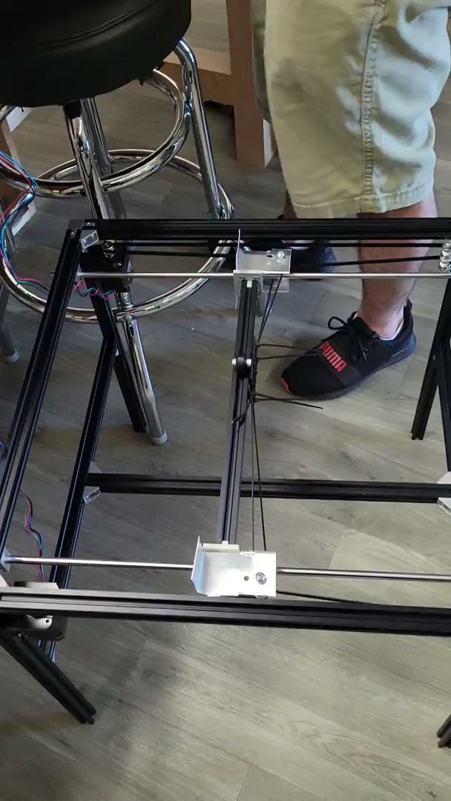
What’s Next?
Integrating Z-axis control for vacuum tube:
This will require a custom gantry plate design to ensure one dimensional movement.
Additional gantry mounted motor adds speed and reliability concerns.
The plate will need to accommodate a motor and the vacuum pump for card movement.
For movements: G-coded files; coordinate to g-code translation; streaming commands.
Begin reliability and repeatability testing for gantry movement.

Slide 5
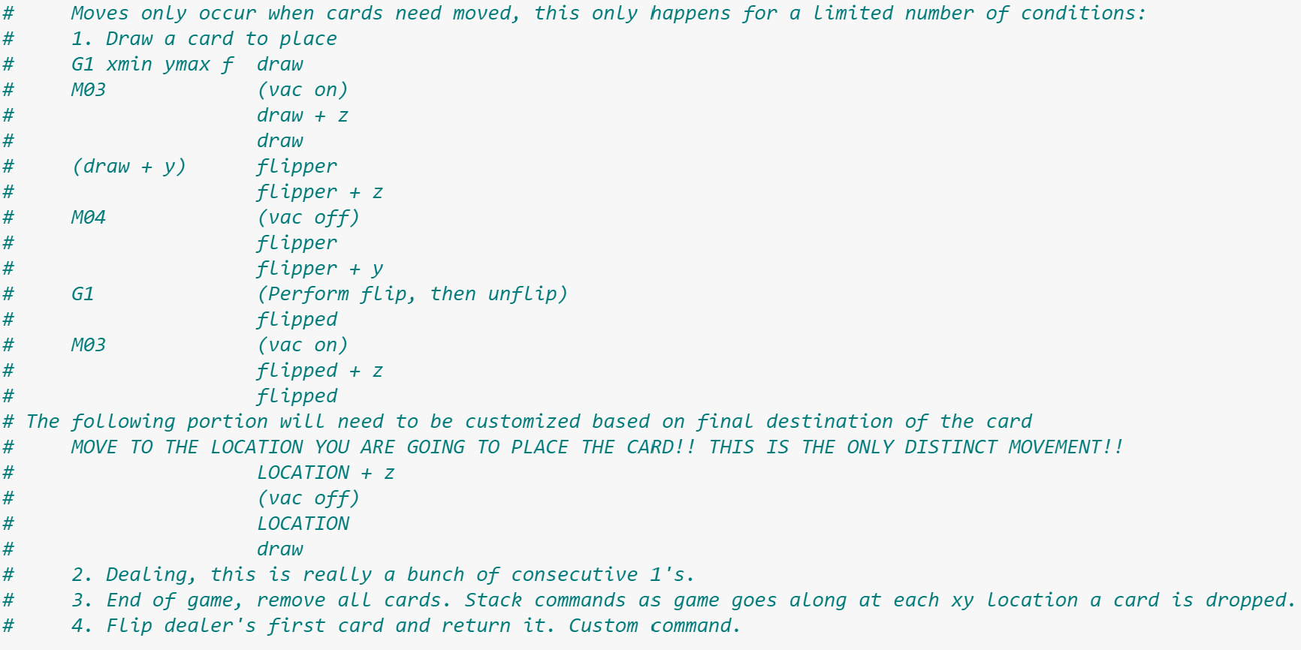

Slide 6
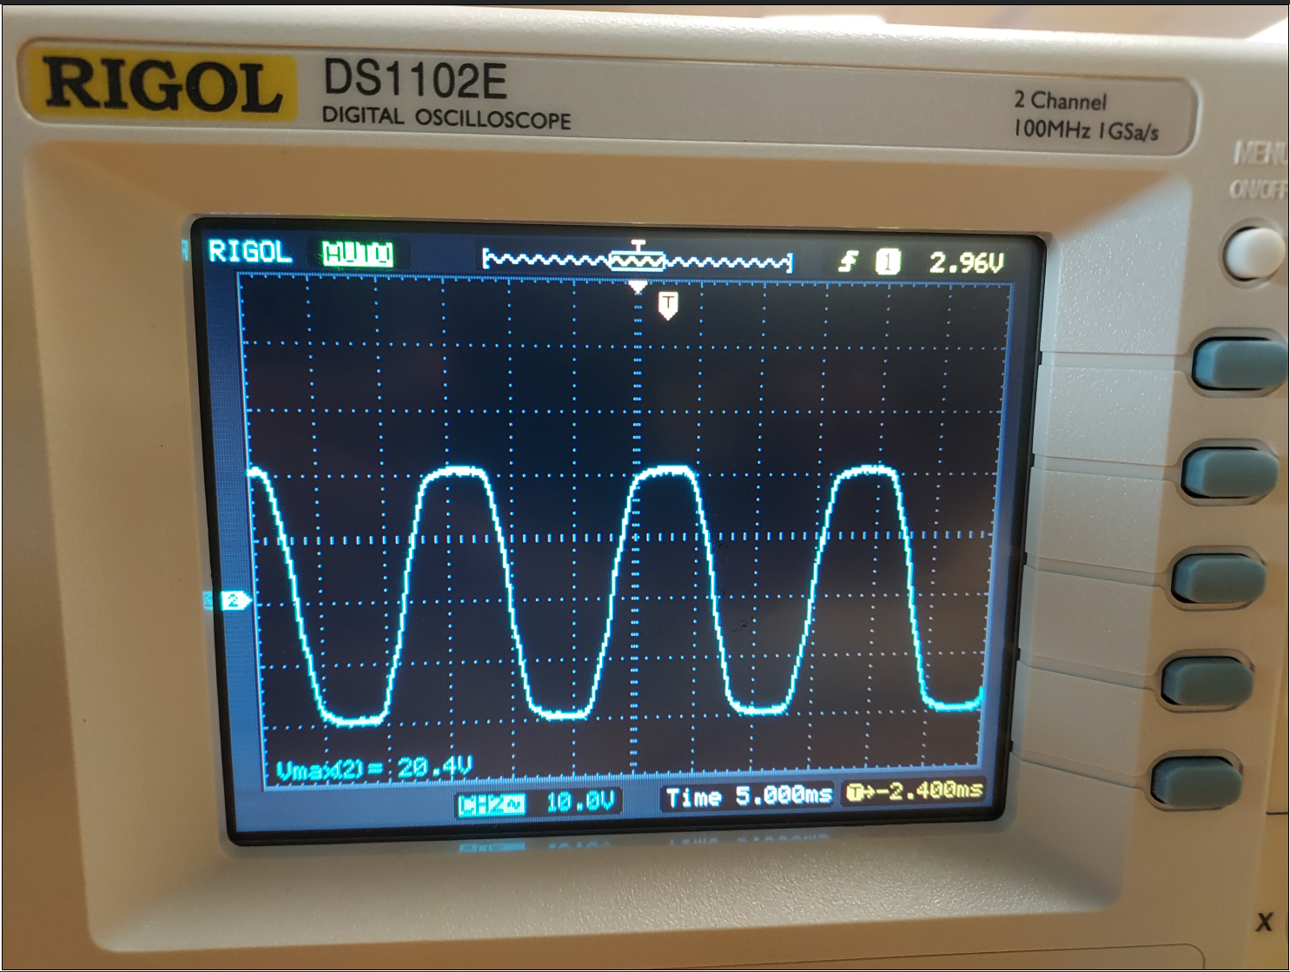
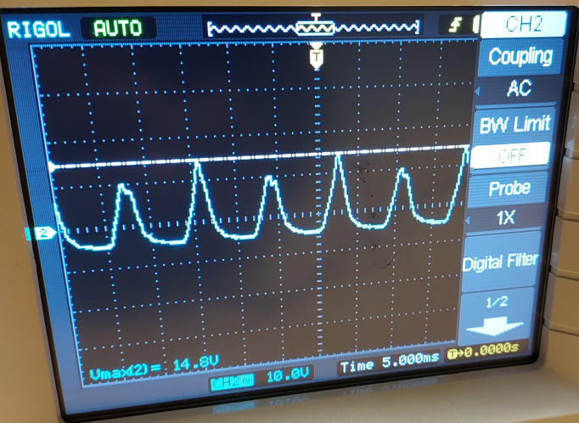
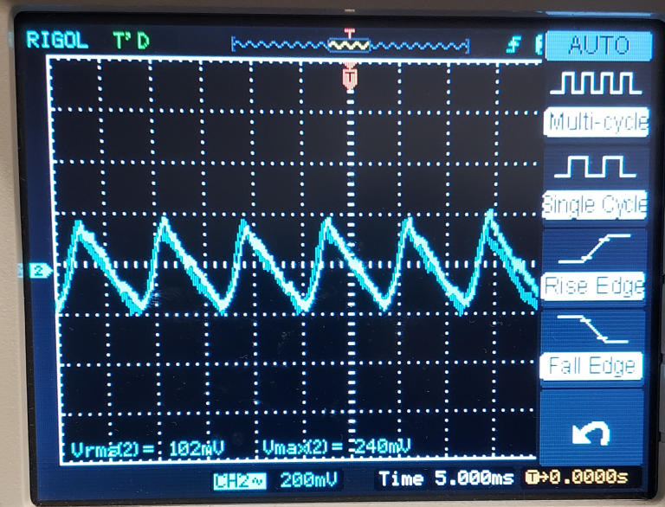
Power System Past and Present
Designed AC-DC conversion circuit for powering systems
115V/30V center tapped transformer.
600V/25A rectifier.
Very low output ripple.
Created insulating enclosure to prevent shock to operators
Connected power supply to initial gantry setup; success
Typical current draw around .5A-.7A for gantry movement.
Expected increase with addition of vacuum pump.
Rectification
Smoothing

Slide 7
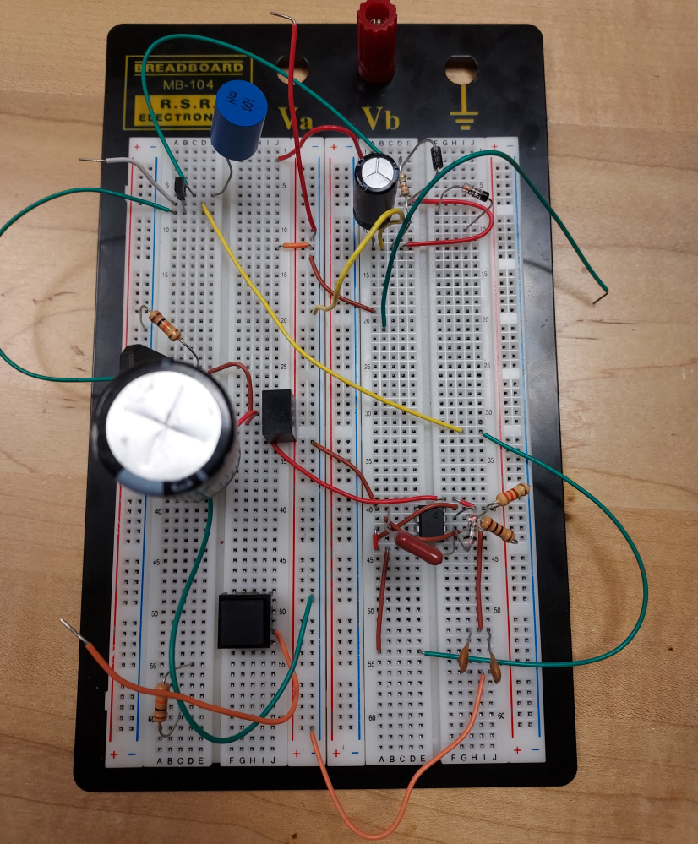
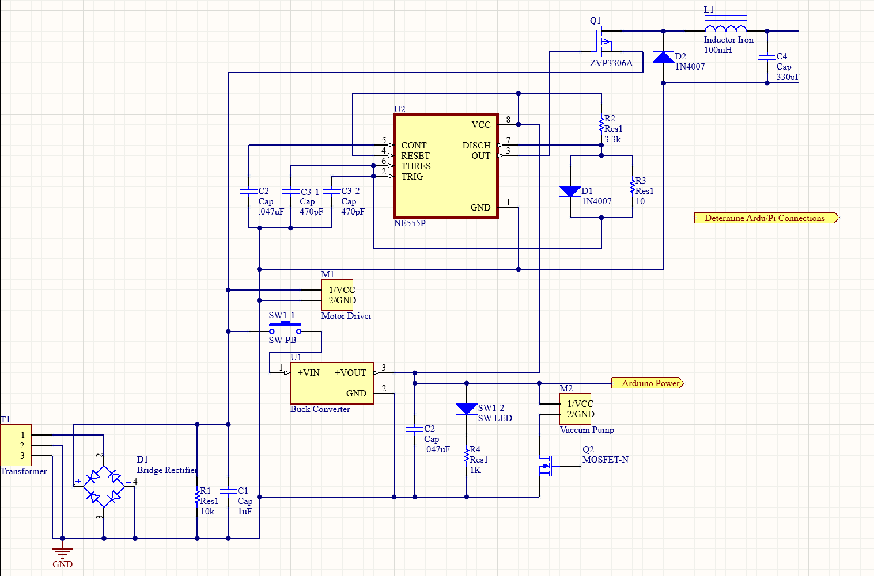
Future Plans
Design a regulation circuit for sufficiently powering a Raspberry Pi
5V/2.5A requirements.
Determine Uno-Pi connections/Finish PCB
Work on mechanics of project
Flipping cards using motor clear acrylic plate.
Designing and 3D-printing parts to be used with motorized components

Slide 8
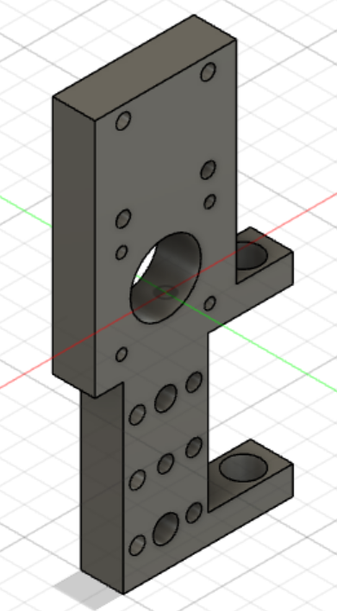
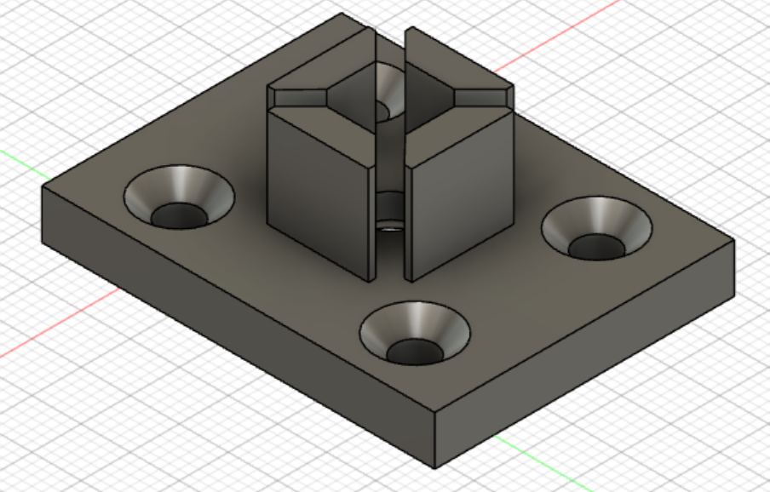
Recap of hardware
Past/Present: Prototype gantry setup, initial power supply setup, motor control.
Future: Finalization of power supply circuits/completed PCB, improvements on gantry setup, flipping mechanism, motor mechanics, fine tuning motor control.

Slide 9
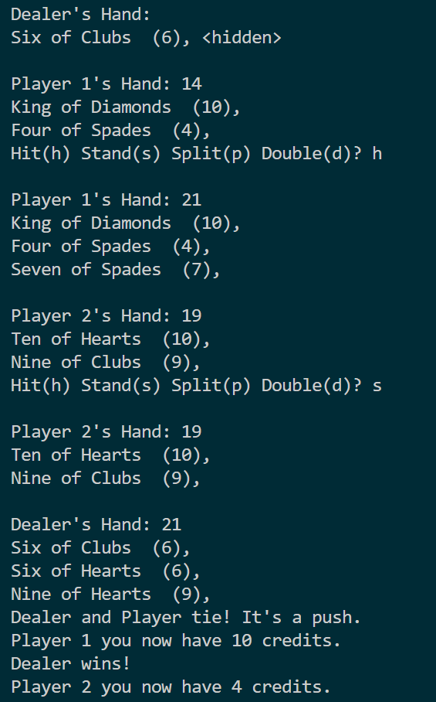
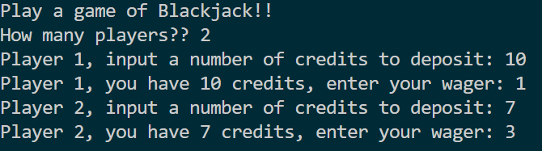
Status Update on Game Logic
Basic Blackjack game functionality works (right)
Wagering and multi-player support implemented (below)
Doubling down and repeat games are functional
Splitting functional but not displaying correctly

Slide 10
Future Steps for Algorithm
Initial Steps Taken
Add insurance and surrendering to wagering
Begin creating input/output display gui
Merge program with Luca’s output
Send messages to Arduino for motor controls
Iron out existing bugs (splitting is a big one)
Develop thorough unit tests and tests scenarios
Touchscreen display delivered and connection tested
Research into I2C connection to communication between modules
Research into controls methodology to assist with implementing Arduino code

Slide 11
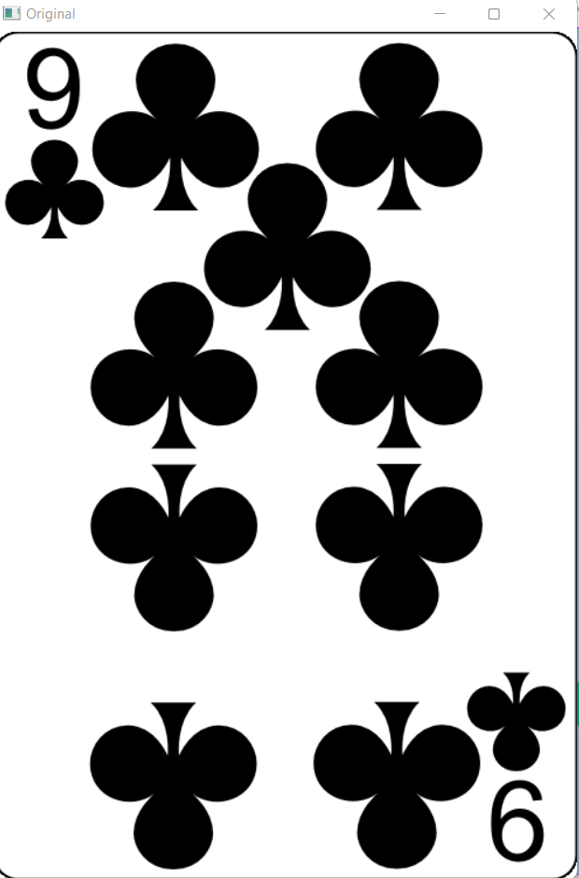
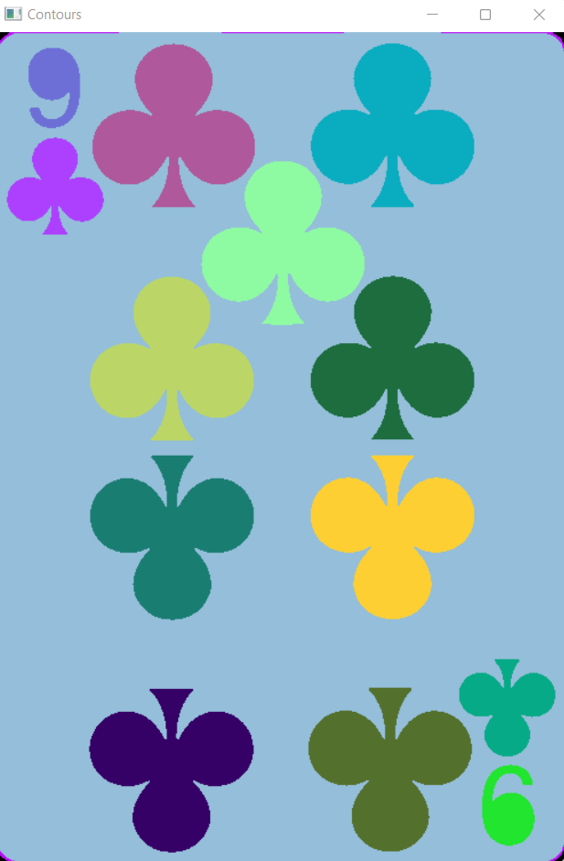


Image Processing Update
Utilizes OpenCV with the Raspberry Pi to capture card image
ArduCam 5MP Mini Camera for Raspberry Pi set underneath acrylic surface on Table
Image captured undergoes Gaussian filtering to filter out noise
Contours are drawn on the image, and the card is cropped out of the image.
Edge detection is used to find the corners of the card, and the card is shrunk to a standard 300x400 pixel Warped image
Value and Suit are cropped out of the top left, and undergo similar filtering to obtain Contours for each.
Compared to test bank of images to predict closest match

Slide 12
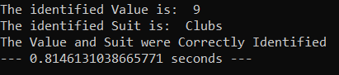
Initial Steps for Image Processing
Future Steps
Wrote algorithm that works 100% of the time using perfect images
Able to read images from the PiCamera with moderate detection success
Runtime is currently under 1 second
Debug algorithm to improve accuracy from real images
3D Print holder for the Camera
Add additional error checking methods to avoid potential misses
Template matching
Contour Counting
Essentially counting the items on the card
Test with Acrylic
Integrate with Curtis’ module on pi
I will send card output
He will send a command for when to capture image

Slide 13
Recap of software
Past/Present: Game Logic implemented, basic cv functionality implemented
Future:
Software modules with basic functionality to be integrated together by or before mid-November
Integrating and communicating with external Arduino to be completed by end of November

Slide 14
Budget: $260
Currently “over” budget. However, the only outstanding item is our power supply PCB. That will be ordered as soon as its design is complete.
The overall gantry and structural design was by far the most expensive part. Including motors, controllers, t-slot, miscellaneous hardware, etc. it took up most of the budget itself.
The structural design itself has lots of opportunity for budget cuts, and that will be Kyle’s responsibility for the rest of the semester.

Slide 15
Schedule
Week 5: Vacuum tube integrated and in testing. Begin software integration.
Week 6: Full XYZ gantry movement powered with designed circuitry. Flipping mechanism design. Game functional with cards read in from camera.
Week 7: Testing, debugging and integration.
Week 8: Full integration. Prototype complete.
Week 9: Finishing touches and prepare for final presentation.

Slide 16
Questions??

